Slide 1
Senior Project
Problems and Progress

Slide 2
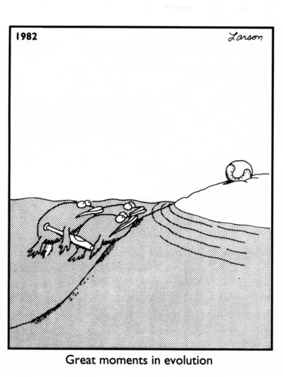
Evolution of A Senior Project

Slide 3
First Goal
My initial goal before I knew much about what a senior project should be I was going to do a simple project but one that could be beneficial to future students in the CS program.
Reasons it was Rejected
It is too simple
It was too much like projects I have done in the past

Slide 4
Second Goal
Next I decided to do and apple application game.
Reasons it was Rejected
Our computer lab doesn’t have xcode
I do not have access to a mac to install xcode on

Slide 5
Third Goal
Third Times a charm
I still was thinking of doing an application so I decided to switch to an android application game and it is currently what I am still working on.
The game I was thinking of doing was a city builder game. There are several of those out on the market but I have some good ideas to make that type of game better.
So no more problems right?

Slide 6
Android Project Problems
First I needed to get used to java which actually wasn’t too bad.
I also needed to figure out an environment to work in. Eclipse is the main one used and that Eclipse ADT was better than Eclipse Juno so I tried ADT even though it is only available on our schools mac machines.
This meant I also needed to learn how to use a mac.

Slide 7
Android Application Problems Continued
After spending a lot of time building an application in java I learned there was a big difference between doing a java application and an android application.
Since I wanted my game to be fairly graphics intensive I started coding it in openGL. Unfortunately android uses openGL ES so I needed to throw my old code away.
Since I was kind of lost starting out with openGL ES. I decided to find a simple tutorial or a walkthrough online.

Slide 8
Android Application Problems Yet Again
This is where I first came across the problem that there are three versions of openGL ES and they can not be mixed and matched. Also certain devices do not support certain versions of openGL ES.
I started with using some simple openGL ES code from a single source (to avoid the mix and match problem).
After putting in some starter code and trying to run it on the emulator I discovered it didn’t work.

Slide 9
Why didn’t it work?
Since my first attempt didn’t work I needed to figure out what was wrong.
Maybe it was emulating a device that didn’t support that version of openGL ES. I then researched which devices used which version and found out that wasn’t the problem.
Maybe the tutorial wasn’t good so I tried code from several other tutorials and walkthroughs. None of those seemed to work either.
After about 7 hours of trying various possible solutions I talked with Bart and found out he has programmed with openGL ES. It turns out he couldn’t get the emulators to run openGL ES projects either but mentioned they work on a physical device.

Slide 10
The Quest For A Physical Device
I didn’t have an android device and I didn’t know anyone who had an extra one they weren’t using(or if they did they didn’t know where it was).
I spent a lot of time researching which android devices used openGL ES and which version of it they used. Then I did a lot of price comparisons on used ones.
Eventually I learned the CIT department had one I could use so I was good.
Since then I got an android cell phone and have been using that as well.

Slide 11
Slow Progress
Progress was very slow with openGL ES. It turns out it is quite different from openGL or GLUT.
The progress was actually so slow I realized I would never get the desired project done in time.
I decided that if I wanted to get a project done by the end of the semester I was going to need some changes.

Slide 12
Changes
First I thought of features I could remove or simplify. But that wasn’t enough.
I thought of changing the project entirely to a simpler one in openGL ES. That didn’t seem like it was enough either.
I realized I just need to drop the whole openGL ES part of my project. I could probably still put together something even if its graphics aren’t as good as I was hoping they would be.

Slide 13
Current Project
I decided a good strategy is to make a game within a game.
I realized my final project has a lot of similarities with the board game Settlers of Catan. So I am currently working on a version of settlers.
If there is time after the settlers game is finished It can be changed to incorporate several of my earlier project ideas.

Slide 14
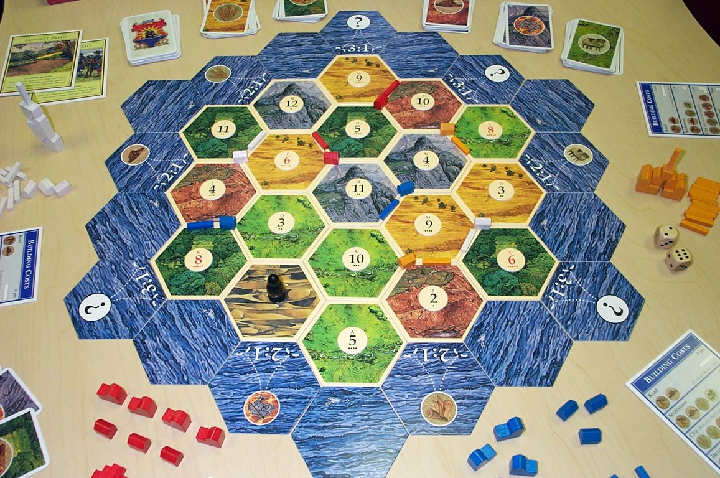
Settlers of Catan (for those that don’t know)

Slide 15
From Settlers To Cities
Some of the similarities between programming a city builder game and a game of Settlers of Catan
Acquisition and spending of resources
Placement of objects in specific places and rules against putting objects in the wrong places
Developing different outcomes based on player decisions
Building a UI that effectively incorporates graphics, buttons, and text
Programming random events and having them trigger specific things in game

Slide 16
Current Functionality
Board setup
Creation of chit objects
Creation of hex objects
Randomizing hex objects
Assigning a chit object to a hex object
Looping through hex objects and drawing them (in progress)
Resource tracking
Depletion of resources when you buy things
Roll dice

